Slide 1
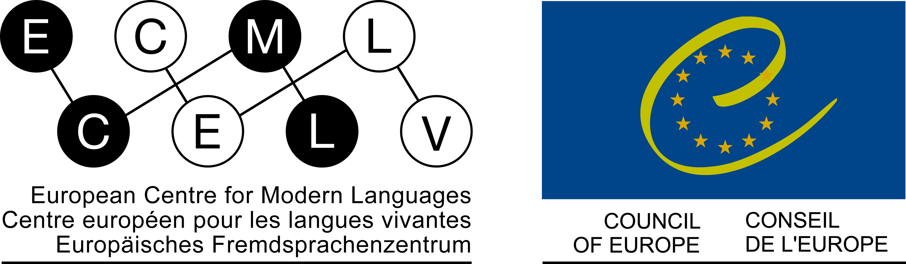


Michel Candelier
言語能力と言語教育：統合的視点と方法

Slide 2
複言語教育とは？
1-複言語主義 vs. 多言語主義
“複言語主義とは、一つ以上の言語を使うことができる能力である”（“話者や学習者の視点から”見た言語）
“多言語主義 […] とは、ある地理的範囲において、誰が話しているかにかかわらず、複数の言語が存在している状態を示す”
(Guide for the development and implementation of curricula for plurilingual and intercultural education – Council of Europe, 2016, 20)
Notes:
In order to ensure that we understand each other correctly, first a question of terminology. What do I mean when I use the word « plurilingual » and its derivatives ?
According to the standard distinction made by the Council of Europe’s experts …
plurilingualism is the ability to use more than one language – this means: language is seen from the standpoint of speakers and learners
multilingualism […] refers to the presence of several languages in a given geographical area, regardless of those who speak them. It is more an external, sociological point of view.
As we know, there are many cases where two or more languages are present in an area, but only apart of the population can use more than one of them.
You can see the origin of this quotation. You will find the entire reference in the bibliography. I will use this Guide quite often and will just say « the Guide ».

Slide 3
複言語教育とは？
2- 追加的 vs. 統合的手順
教育において、また教育を通して複言語主義を目指すこと…
- 追加的（量的）ではない：学生が学ばなければならない言語の数を単純に増やすことではない
統合的（質的）：“全ての言語教育の統合、集合または横断的編成”を通して行われる (Guide, 16).
Notes:
Aiming at plurilingualism in and through education is not a matter of simply increasing the number of languages students have to learn. It is not an additive – a quantitative – matter.
It is a qualitative one, which requires the integration, convergence or cross-cutting organisation of all language teaching.
This is a crucial point – and maybe the most important one of what I would like to tell you. This assumes that you cannot reach your objectives for your students – such as developing interest for languages, improving language skills globally as well as the ability to learn languages – if you don’t take this integrative way.
My task is now to justify this assertion, but also to show what this means, including by concrete examples.

Slide 4
なぜ統合的方法か？
複言語教育では“話者と学習者”の複言語能力とは何かを考慮しなければならない（学習者中心の教授法では自明的な側面）。
複言語・複文化能力の定義 :
“ある個人は、ばらばらで別々のコミュニケーション能力の寄せ集めをその人が知っている言語ごとに持つのではなく、むしろその人が使用可能な言語の全範囲を包含する複言語・複文化能力を持つのである”
(Common European Framework of Reference for Languages, Council of Europe, 2000, 168).
Notes:
In order to be really « plurilingual », plurilingual education has to take into account what plurilingualism is. This means more precisely – because as we have just seen « plurilingualism » is something which has to do with le « standpoint of speakers and learners » - to take into account what plurilingual competence is. Which seems to be an obvious and essential dimension of learner centered teaching.
>> (>> = click) The definition promoted by the Council of Europe also includes cultural aspects, which are not the central topic of my conference today. But this definition does emphasise the aspects we need now to consider.
>> Please, read this definition:
“a given individual does not have a collection of distinct and separate competences to communicate depending on the languages he/she knows, but rather a plurilingual and pluricultural competence encompassing the full range of the languages available to him/her”
This range of languages an individual has a knowledge of – including those he or she partially knows – represents what is often called her or his repertoire.
What this definition states is that the plurilingual competence is not an addition of separate competences for each language the competence is made of. The competence has to be considered as a single one, covering all languages of the repertoire.

Slide 5
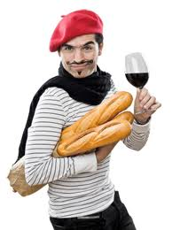
これがどういう意味か理解を深めるために、具体的な例を紹介しましょう。
……これは、ドイツ語を知っていて、これから日本語を学ぼうとしているフランス語話者についてのお話です。
実は、これは数年前に日本に滞在した時の私の話なのです！！！
きっとお分かりになるでしょう。
他のフランス語話者にとって（また多くの他の学習者にとっても！）日本語の難しさの一つは、動詞を文の最後に置くことです。しかし私にはこの問題がありません。なぜでしょうか？
Notes:
5
Our young friends would like to give you an example in order to allow a better understanding of what this means.
It is about a speaker of French who knows German and tries to learn some Japanese.
>> Actually, it's about me when I stayed in Japan a few years ago. You will for sure recognize me!
>>For other people speaking French (and many other learners!) one of the difficulties in Japanese is to put the verb at the end of the sentence. I don't have this problem. Why?

Slide 6
私はドイツ語を学んだことがあり、使うことができます。
わたし は
せんせい
です
日本語
watashi wa
sensei
desu
I
teacher
am
V
(dass)
ich
Lehrer
bin
ドイツ語
V
ドイツ語においても、少なくとも従属節においては、動詞は最後に来ます！
Notes:
6
I have learnt German and have a good mastery of it.
….
>> And in German too, the verb is at the end, at least in dependant clauses!

Slide 7
ドイツ語の学習中に、動詞を最後に置いて文を構成する能力を自分の複言語能力に取り入れました。
その後、この能力は日本語で文を構成する助けになりました。そして学びたい他の言語においても自由に使える能力なのです。…
つまり、私の複言語能力は包括的なのものといえます。日本語を話そうとするときには、私は日本語とドイツ語の両方に共通の能力を使用するのです！！
Notes:
7
While learning German, I have been introducing into my plurilingual competence the ability to build up sentences with the verb at the end.
>> Later on, this ability helped me constructing sentences in Japanese. And it is at my disposal for other languages I would like to learn.…
>> Thus, my plurilingual competence is a global one: when trying to speak some Japanese, I use an ability that is common to both Japanese and German!!

Slide 8
この複言語能力の概念は、何十年にわたる言語習得と言語使用に関する心理言語学の研究に依拠する。
この“全体論的”（包括的）視点の発展経緯の概要については、以下を参照
Jessner (2008). Multicompetence approaches to language proficiency development in multilingual education.
いくつかの重要な構成概念について…
私たちの専門用語では“複言語”
Notes:
This conception of plurilingual competence relies on psycholinguistic research work carried out on language acquisition and use in the last decades. You can find a very good overview of how this so called “holistic” – this means “global” - view of plurilingual competence has developed in a book by Herdina and Jessner.
I will now outline a few essential elements.
Note that most English-speaking authors still use “multilingual” here, instead of “plurilingual”.

Slide 9
Grosjeanの研究 (1985)
バイリンガリズムの全体論的視点
彼は以下の両研究に強い影響を与えた…
… Cookの概念であるマルチコンピテンス[multicompetence](1991))…
…そしてHerdina and Jessner (2002)の多言語発達と多言語能力に関するダイナミックな概念
Notes:
Everything has started with Grosjean, who was the first linguist to introduce a holistic view of bilingualism.
He strongly influenced both Cook’s concept of “multicompetence” and Herdina’s and Jessner’s dynamic view of plurilingualism.

Slide 10
Grosjeanのバイリンガリズムに関する複言語的視点 :
バイリンガル（二言語話者）は、2人のモノリンガル（単一言語話者）を合体させたものではない。バイリンガルは、運用可能な二つの言語の共存と継続的な相互作用の結果として生じた一つの特殊な言語構成を持っている。
… Cookの概念であるマルチコンピテンス[multicompetence](1991))…
…そしてHerdina and Jessner (2002)の多言語発達と多言語能力に関するダイナミックな概念
Notes:
According to Grosjean, bilinguals are NOT the sum of two monolinguals. They have a specific linguistic configuration that is resulting from the coexistence and constant interaction of the two languages they have a command of.

Slide 11
Grosjeanのバイリンガリズムに関する複言語的視点 …
Cookの概念であるマルチコンピテンス[multi-competence]
Herdina and Jessner’s Dynamic model of Multilingualism (DMM) (2002) :
“[…] 私たちはバイリンガリズム（二言語使用）の現象 […] は本質的にマルチリンガリズム（多言語使用）の一つの変種であると考えており […]それに関する多くの知見が […]マルチリンガリズムの全ての変種に適用できると考えている。
DMMは多言語話者を、個々の言語体系で構成される一つの複合的な心理言語的体系として捉えている […]”
その結果…
新たな言語体系の構成は既存の言語体系と併せて運用されなければならない。これこそ私たちが“統合的方法”と呼ぶものである。
Notes:
For reasons of time, I'm going to leave aside Cook’s concept and I’m focusing on Herdina’s and Jessner’s Dynamic model of Multilingualism (DMM).
The first assertion is that bilingualism is a particular case of plurilingualism – in their words multilingualism. And that what is said by Grosjean for bilingualism is also true for plurilingualism.
The second one is exactly what has been said above concerning plurilingual competence: the plurilingual speaker “is a complex psycholinguistic system comprising individual language systems”.
As a consequence :
>> The construction of any further individual language system must be carried out in conjunction with existing individual language systems. This is exactly what we called “the integrative way”.

Slide 12
一つ目の具体例
フランス語に特徴的な難しさ: « un »の二つの意味
J’ai acheté un livre
我买了书。
我买了一本书。
I have bought a book
I have bought one book
学生が冠詞の概念を養ってきた英語では、フランス語の冠詞（un）は二つの意味を持つ。一つは数詞であり、もう一つは不定冠詞である。英語を経由＝適切な方法！
Cuet C., Li Z., Marguerie A., 2008. Français, communication et pratique.
Notes:
I have also promised some concrete examples. Just to show that these principles lead to very concrete and often simple measures.
The first one will be taken from a textbook of French for Chinese students. But it deals with a problem Japanese students also have to face.
>> In French, « un » stands either for the indefinite article or for the numeral « one ». « J’ai acheté un livre » can mean « a book » or « one book ».
The challenge is made all the more difficult by the fact that Chinese has no article.
>> For students having already learnt English, English is the language in which they have developed the notion of article, and it does have two forms, one for the numeral, and one for the article. So that the way trough English should help them.
This “way trough English” is not an additional means to be used as a simple remark.
In consideration of the existing plurilingual competence of the students, it is the only proper strategy to be adopted.
This is just one case among many. So that helping students to develop competences in any further language needs to be seen as a common task to be reflected upon by all those who are in charge of the languages of the curriculum.

Slide 13
二つ目の例：大学生向けのアクティビティ。大山万容先生 (京都大学)による複言語教育の授業。
ETAT-NATION : DEFINITION DE L’UNESCO
"L'Etat-nation est un domaine dans lequel les frontières culturelles se confondent aux frontières politiques. L'idéal de l'Etat-nation est que l'Etat incorpore les personnes d'un même socle ethnique et culturel. Cependant, la plupart des Etats sont polyethniques. Ainsi, l'Etat-nation "existerait si presque tous les membres d'une seule nation étaient organisés en un seul Etat, sans autres communautés nationales présentes. Bien que le terme soit souvent usité, de telles entités n'existent pas". 理解できるか試してみてください！
Notes:
For a second example, I have chosen an activity designed by Mayo Oyama, our colleague from Kyoto, who teaches an intermediate French class employing plurilingual teaching materials. She is taking part in our symposium and you can ask her later on for more details.
This seems to be a quite difficult text in French. Maybe, you start reading the beginning …
…
I think you were able to get the meaning quite properly. If you have thought of “confusion” for “confondre”, you were likely to get a thorough comprehension of the first sentence.

Slide 14
"L'Etat-nation est un domaine dans lequel les frontières culturelles se confondent aux frontières politiques.
L'idéal de l'Etat-nation est que l'Etat incorpore les personnes d'un même socle ethnique et culturel.
Cependant, la plupart des Etats sont polyethniques.
Ainsi, l'Etat-nation existerait si presque tous les membres d'une seule nation étaient organisés en un seul Etat, sans autres communautés nationales présentes.
Bien que le terme soit souvent usité, de telles entités n'existent pas"
Notes:
Indeed, this is true of the whole text. Of course, this text belongs to a domain – that of politics – where languages like Greek and Latin have had an important influence on different European languages.

Slide 15
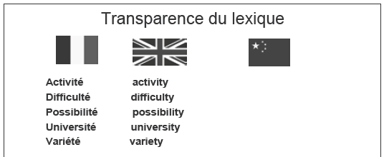
Taken from Cuet C., Li Z., Marguerie A., 2008.
sincérité
curiosité
égalité
réalité
amabilité
sincerity
curiosity
egality
reality
amability
語彙の一般的な側面でも！
Notes:
But lexical similarity occurs quite often between French and English, also in non specialised areas of vocabulary.
>> As you see, correspondences can be established between morphological elements.

Slide 16
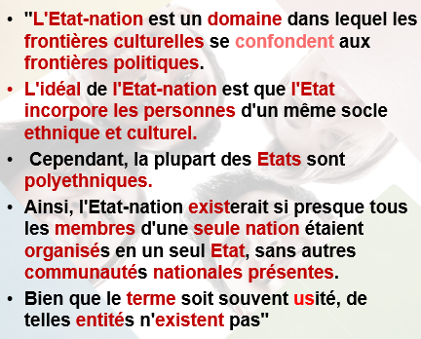
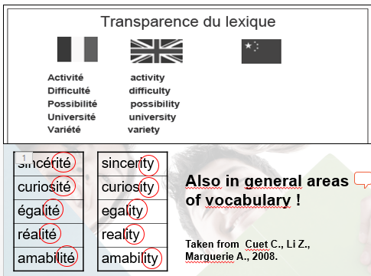
ますます多くの言語を学ぶモチベーションとなる！
ある言語を学ぶ際に既知の言語から手助けを探すように学生を奨励する。
学生は便利な複言語的方略を身につける。フランス語学習は決して時間の無駄ではない。英語の能力も強固にする。
普段の授業で英語＋フランス語を試してみませんか？
Notes:
Such activities are important for motivation – motivation for learning languages and more languages.
They encourage the students learning a language to look for help in other languages they know.
And this includes Japanese - think about the many borrowings in Japanese.
In this way, students develop useful strategies, plurilingual strategies.
This is by no means a waste of time for learning French. And this reinforce competences of English, so that one could think of doing this work during teaching hours that would be common to both languages.

Slide 17
これまでの内容は、皆さんが心の中でお持ちであると思われる質問を想定し、私がお話できることのなかから重要部分をまとめました！
これからお話しすること:
複言語教育に関するその他の理論
その他の例（語彙的側面を超えて）
参照の枠組み（複言語と相互文化的教育を通して発展させる知識、姿勢、技術）
Notes:
What I have told you so far is the essential part of what I can tell you, given what I think I know about the questions you are asking yourself.
>> In the following,
I will first complement the principles already stated concerning plurilingual education.
I will then present other examples which will go beyond the lexical aspects.
And I will present a framework of reference with lists of knowledge, attitudes and skills to develop through plurilingual and intercultural education that can be useful to you in the future.

Slide 18
複言語教育に関するその他の理論
共通点…そして相違点：
“橋渡し（する能力）の発達には、カリキュラムにおける言語間の共通点と相違点の活用が必要とされる。 […]対照分析もまた顕著な特徴と相違を明らかにする”（Guide 11, 及び2.6）
言語を通して“自分たちのやり方を見つける”ために、学生たちは何が違うのかということを明確に把握する必要がある。
Notes:
As we are limited in time, I will state these principles quickly, with few comments. They are taken from the guide we started with. I invite you to continue your reflection at a later stage on the basis of the developments that the guide provides on these themes.
>> The first principle claims that it is not enough to make similarities manifest. The differences are also important :
“The development of cross-linkages calls for utilisation of the similarity and dissimilarity between languages in the curriculum
[…] contrastive methodology will also bring out the distinctive features and the diﬀerences.” (more in 2.6)
Of course, similarities are the most striking argument in favor of plurilingual approaches – the most visible one. But students need to “find their way” through languages. In order to do this, they also need to have a clear view of what is different.
>>

Slide 19
複言語教育に関するその他の理論
洞察力、学ぶための学習、自律性
“[Guideでは]文法教授における洞察力（reflexivity）を促進させるアプローチに特別な焦点があてられる。[…] より横断的な視点がそういった活動に効果をもたらす。というのも、言語というのは、他の言語に由来するデータを基準として分析されるのものだからだ。[…]この他言語頼みの方法は常に多くの示唆を与えてくれる。対比を指摘することにより、変化した焦点が、言語がどのように機能しているのかを際立たせるからだ。”
« 文法 »その他の種類の規則性を含む
« 文法教授における洞察力（reflexivity） » = 明示的な文法 + 帰納的方法
Notes:
I've put together the principles that relate to reflexivity, the competence to learn and learner autonomy.
>> Please, read the quotations :
“[In the Guide] particular attention is paid to approaches encouraging reﬂexivity in grammar teaching. […] such activities would benefit from a more cross-cutting perspective, since there is nothing to prevent one language from being analysed on the basis of data stemming from others. […]. This recourse to other languages is always revealing, since the change of focus highlights how languages function by pinpointing contrasts.” (Guide, 11, 42 – see 2.4)
>> Some remarks are needed:
In “grammar teaching”, grammar has to be understood very broadly: it includes other types of regularities in the linguistic system and even such concerning the use of language.
What is meant here is often dealt with in terms of explicit grammar. But the choice of “reflexivity” instead of “explicit” is important. This is why the guide devotes a great deal of attention to the question of modalities of grammatical reflection, putting inductive methodology in the centre of its recommendations and recognizing that it is still very remote from the professional culture of most language teachers and learners.

Slide 20
複言語教育に関するその他の理論
洞察力、学ぶための学習、自律性
“[…]洞察力（reflexivity）は[認知]距離という要素を学習のプロセスに対するある種の気づきという形でもたらす働きがある。[…]一般的にこの（認知）距離のプロセスは学習者の知識を習得したり転移させたりする能力を向上させることで知られている。[…]
[目的は]学習者の自律性の発達、追究すべき目標について考える学習者の能力と彼らの言語的及び（相互）文化的経験、彼らの成長と彼らが持つであろうあらゆる批判的観察である” (Guide, 38, 28)
Notes:
Again, read the quotations. It is now about reflexivity in a broader sense, not limited to regularities in languages, but applying also to cognitive activity by learning, thus promoting the development of the competence to learn and more generally learner autonomy :
“[…] reﬂexivity serves to establish an element of distance from [cognitive activities] in the form of a certain awareness of the processes used in learning. […] It is generally agreed that this distancing process improves their capacity for acquiring and transferring knowledge […] (Guide, 38)
[The aim being] the development of learner autonomy, the ability of learners to think about the aims pursued and their linguistic and (inter)cultural experiences, the progress they are making and any critical observations they may have.”

Slide 21
複言語教育に関するその他の理論
洞察力、学ぶための学習、自律性
文法的洞察力についてこれまで述べてきたことへの補足：“[…]学校での教授活動で用いられる主要な言語を他言語の教授に連携できるように、他言語を教授するときだけでなく、科目としての就学言語においても、より多くのことがなされるべきである。” (Guide, 41)
学習者に焦点をあてる 他言語を教授する教師は就学言語を学習者のレパートリーを構成する重要な要素として考慮に入れなければならない。
Notes:
In addition to what has been said about grammatical reflectivity, some words about the main language of schooling – in your case, Japanese:
Plaese, read this short quotation :
“more should be done to relate the main language of schooling to the foreign languages taught, not only when the latter are being taught but also in the language of schooling as a subject”.
>> It is only understandable that teachers of foreign languages think first of all about teaching these languages, but if they really want to focus on the learner, they must take into account the language of schooling as it is an essential element of their repertoire.

Slide 22
複言語教育に関するその他の理論
複言語…そして相互文化教育：
“複言語及び相互文化教育は二つの目的がある。一つ目は、言語的及び相互文化的能力の習得を促進させること。[…]二つ目は、人格形成を促すこと […]: これにより[ひとりひとりが]多言語及び多文化社会における言語と文化の多様性を尊重し受け入れることを奨励する[…]。” (Guide, 15)
ガイドでは二つの用語を使っている：
“複文化性とはさまざまな文化に参加する能力を意味する。相互文化能力とは、他者性と文化多様性を経験する能力である[…]。” (Guide, 10)
Notes:
As already suggested, plurilingual education goes hand in hand with plurilingual / intercultural education, which is not the aspect I am supposed to develop here.
Two quotations on this point:
>> “Plurilingual and intercultural education has two aims. First, it facilitates the acquisition of linguistic and intercultural abilities […] Secondly, it promotes personal development […]: this involves encouraging [individuals] to respect and accept diversity of languages and cultures in a multilingual and multicultural society […].”
More and more terms are used in the complex domain of education to cultural diversity.
>> The Guide tries to cover it with two of them : Pluriculturality, which has more to do with the cultural repertoire of the invidual, and interculturality, which focuses on the relationship to others.
“Pluriculturality denotes the ability to participate in diﬀerent cultures.
Intercultural competence, for its part, is the ability to experience otherness and cultural diversity […].” (Guide, 10)

Slide 23
複言語教育に関するその他の理論
複言語及び相互文化教育と社会
“こうした複言語及び相互文化教育を構成するさまざまな要素には受容性と社会的結束を強化する働きがある。それらは民主的市民性への準備であり、知識社会の確立に貢献する。” (Guide, 16)
Notes:
And the Guide shows how plurilingual and intercultural education is connected with global aims concerning society: inclusion, social cohesion, democratic citizenship and a knowledge society.
.

Slide 24
さらなる例 – 語彙的側面を超えて
英語の後にドイツ語を学ぶ例、Kursiša, A. & Neuner, G. (2006)より
両言語における法動詞について
I really must go now
Ich muss jetzt aber wirklich gehen
Notes:
Now a second series of examples that will be a little more complex than the first.
We start with students learning German after English. It is about modal verbs in both languages.
>> It should be obvious that somebody having already learnt I really must go now will try – consciously or not – to establish links with English when learning Ich muss jetzt aber wirklich gehen.

Slide 25
違いもある！語順の文法領域において
自分の言語と比較：日本語には法動詞がない！
Notes:
This material helps students to discover not only lexical similarities, but also differences that exist in the grammatical domain of word order.
>>They also compare with their own mother tongue (and / or language of education), which would be all the more interesting for your students as these forms do not exist in Japanese.

Slide 26
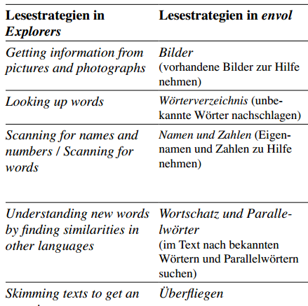
さらなる例 – 語彙的側面を超えて
読解方略に関する洞察力
生徒（中等教育レベル）は英語（教書:Explorers）の後にフランス語（教科書：Envol）を学ぶ （Achermann, B. 2009より
Reading strategies in Explorers
Reading strategies in Envol
Reste à traduire en EN !!!!
読解の方略についてはそれぞれの教科書ですでに考察している。各教科書における記述を比較し、自分に合う方略を示す。
複言語方略！
Notes:
The next example is no longer about reflexivity on how languages work, but on own strategies.
>> The students - at secondary level - learn French (with the course book: Envol) after English (course book: Explorers).
>> They are reminded that they have already reflected on reading strategies in each textbook, and they are asked to compare the formulations in each textbook and to indicate their preferred strategies.
One of these strategies is looking for similarities with languages they already know. It is a plurilingual strategy.

Slide 27
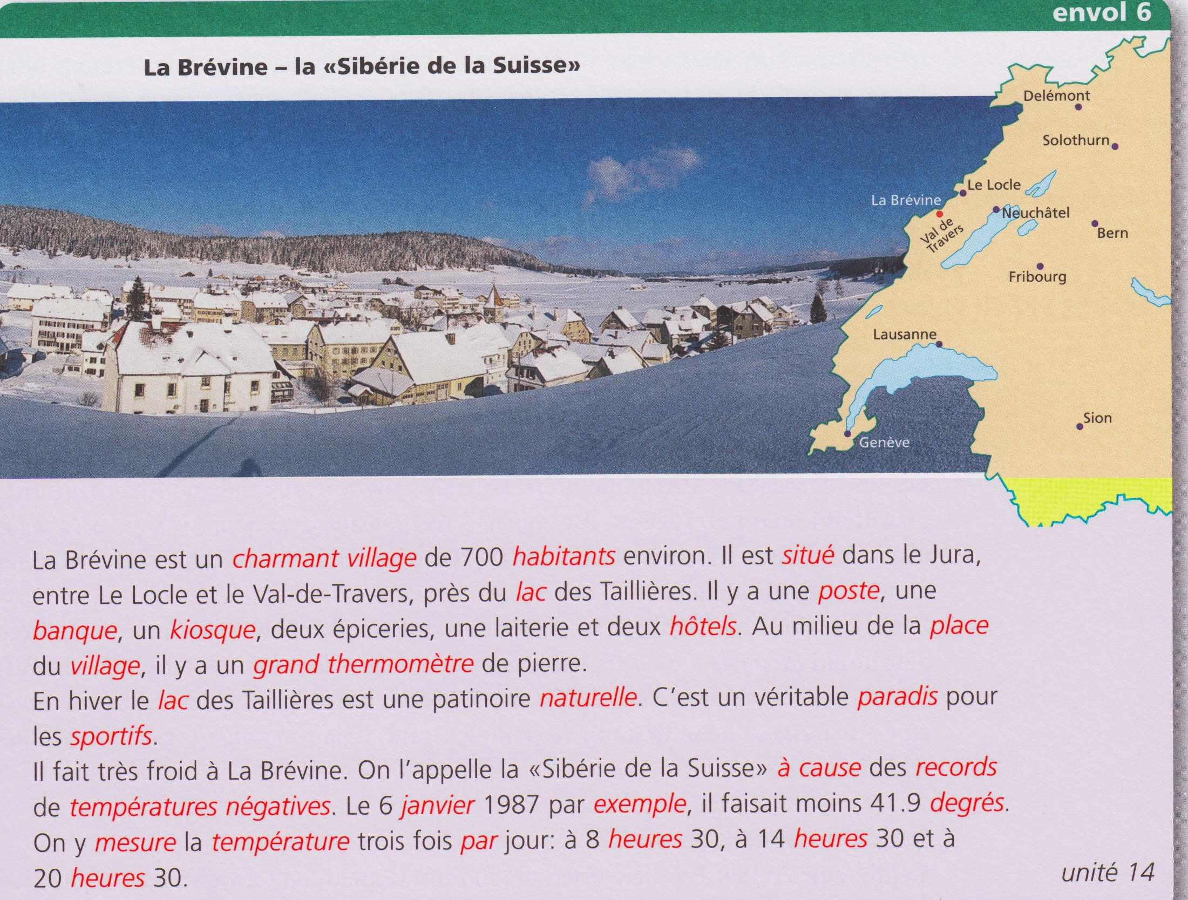
（語彙的）類似性＝複言語の読解方略を他の方略と併用するための土台となる
Egli Cuenat M. et al., 2018
Notes:
… (le temps de regarder)
>> Similarities - particularly lexical ones - between languages are therefore the underpinning for a plurilingual reading strategy, which students are encouraged to use along with other strategies.

Slide 28
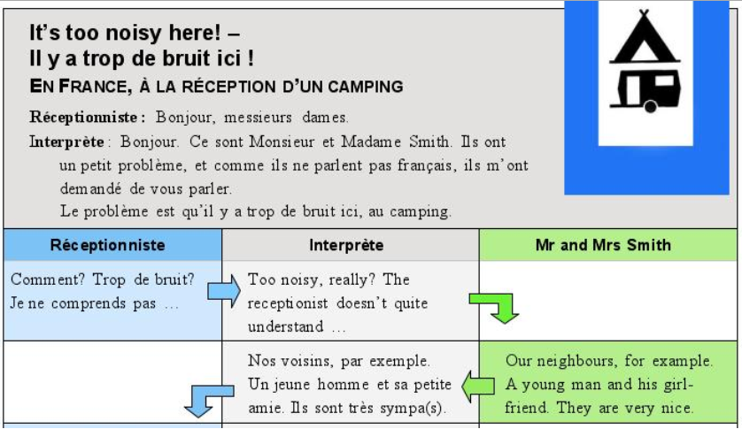
Further examples – beyond lexical aspects
ドイツの中等教育レベルの生徒が行う媒介活動。3人構成で、英語話者とフランス語話者が互いの言語を話さないため、1人の学習者が言語媒介者 -“通訳者”- となる。フランスのキャンプ場を想定している。
Mediation activity
Notes:
…
This so-called „mediation“ activity is also for German secondary school students, but the situation is equally suitable for university students.
This is a three-person constellation in which a learner takes on the role of a language mediator – an “interpreter” - between English and French-speaking persons, since these persons do not speak the other language. This is supposed to take place on a camping site in France.
.

Slide 29
Further examples – beyond lexical aspects
受付係（フランス語で）： “こんにちは”…
媒介者（フランス語で）： “スミス夫妻からあなたに伝えるよう頼まれました…ここはさわがしすぎます！”
Mediation activity
受付係（フランス語で）：“そんなにさわがしいですか？おっしゃっている意味がわかりません。”
媒介者（英語で）： “さわがしいですか、ほんとに？受付係はよくわかっていません。”
スミス夫人（英語で）：“例えば、近所の方ですよ。若い男性と彼の彼女。彼らはとても良い方です…”
媒介者（フランス語で）： “例えば近所の方ですよ。若い男性とその彼女。彼らはとても良い方です…”
媒介＝翻訳、通訳、要約、あるいは報告
Notes:
…
…
>> As you can already see, mediation is not about giving an accurate translation of what has been said. Other forms of mediation are interpretation, summary or report.
.

Slide 30
さらなる例 – 語彙的側面を超えて
媒介活動
この非常に簡単な媒介の例ではこの種の教授・学習活動の可能性について限られた視点しか提供していない。
Notes:
This is a very simple example of mediation, which gives you only a limited view as to the potential of this type of teaching and learning activity.
.

Slide 31
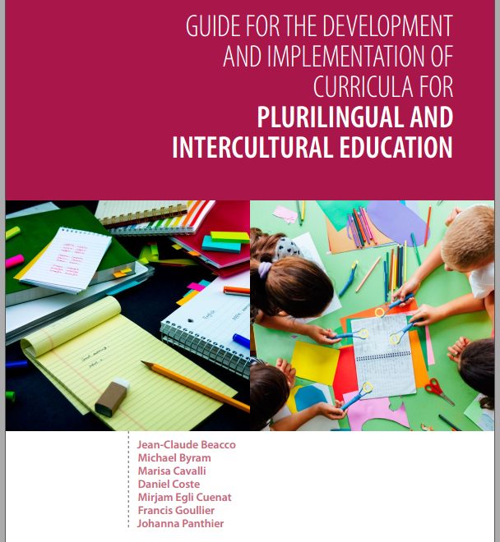
詳細はGuide (53-59)を参照
言語的媒介＝ 全ての教授及び学習プロセスに偏在する一般的な現象として捉えられている媒介の特殊な形態
媒介活動の文化的側面
複言語及び相互文化教育における媒介の中心的役割（FREPAとの強い関連性）
Notes:
I would strongly advise you to have a look at what the Guide says about this. You will learn more about:
>> Linguistic mediation (what we have just seen) as a special case of mediation conceived as a general phenomenon that is omnipresent in all teaching and learning processes.
>>The importance of the cultural dimension of mediation activities.
>> The central role of mediation in plurilingual and intercultural education.
Here, you will find a strong reference to FEPA, the framework I would like to present now.

Slide 32
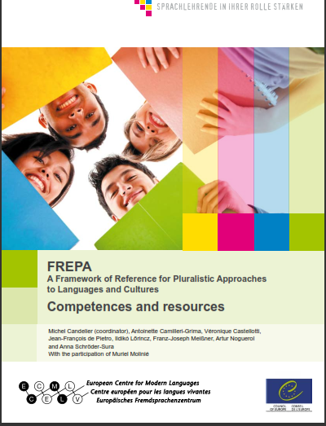
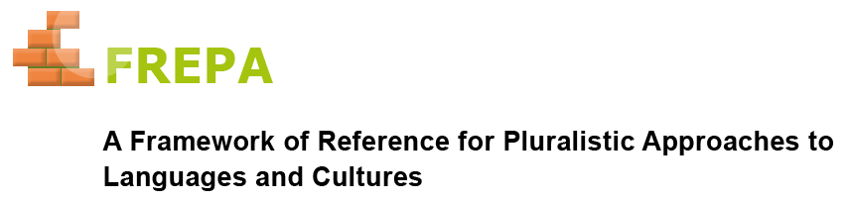
FREPA－複言語及び相互文化教育への方法
複言語教育の教授と学習の目標について具体的に考えさせてくれる方法（Guide, 69を参照）。
ミシェル・カンドリエ（コーディネーター）
Notes:
This instrument is not made just for Mediation, but for all aspects of plurilingual and intercultural education. It can help you to think in concrete terms about the teaching and learning objectives of plurilingual education, and thus to organise collectively an education that puts languages in relation to each other.
>>
>> I coordinated the development of this instrument at the European Center for Modern Languages in Graz, which is also an institution of the Council of Europe.

Slide 33
複元的アプローチとは何か？
2種類の教授的アプローチには違いがある：
言語と文化に対する複元的アプローチとは、複数の（i.e. 一つ以上の）言語あるいは文化の変種に関わる指導/学習活動を扱った教授的アプローチを指す。
“単一的アプローチ”とは、一つの言語や特定の文化のみを考慮し、それらを単独で扱う教授的アプローチである。
全ての言語教育を統合する
（複言語教育）
Notes:
But I presume you'd like to know first of all what pluralistic approaches are.
Please, read the definitions carefully.
(ne pas lire)
>> If you are supposed to integrate all language teaching, as we said above, you must plan some activities involving several languages. You can’t do it by dealing with languages in isolation.

Slide 34
複元的アプローチとは何か？
2種類の教授的アプローチには違いがある：
言語と文化に対する複元的アプローチとは、複数の（i.e. 一つ以上の）言語あるいは文化の変種に関わる指導/学習活動を扱った教授的アプローチを指す。
“単一的アプローチ”とは、一つの言語や特定の文化のみを考慮し、それらを単独で扱う教授的アプローチである。
単一的アプローチは複元的アプローチに取って代わられるのではない。
単一的アプローチは複元的アプローチにより充実される。
このことは複言語及び相互文化教育の文化的側面についても言える。
全ての言語教育を統合する
（複言語教育）
Notes:
This does not mean that you do not keep concentrating learners' efforts on a particular language at certain points in the learning process. But it is essential to provide for other phases where you have the languages linked to each other. This means phases of pluralistic approaches.
In other words: singular approaches are not replaced by pluralistic approaches. Singular approaches are enriched by pluralistic approaches.
>>This also applies to the cultural dimensions of plurilingual and intercultural education.

Slide 35
複言語及び相互文化教育は複元的アプローチを必要とする。
2種類の教授的アプローチには違いがある：
言語と文化に対する複元的アプローチとは、複数の（i.e. 一つ以上の）言語あるいは文化の変種に関わる指導/学習活動を扱った教授的アプローチを指す。
“単一的アプローチ”とは、一つの言語や特定の文化のみを考慮し、それらを単独で扱う教授的アプローチである。
単一的アプローチは複元的アプローチに取って代わられるのではない。
単一的アプローチは複元的アプローチにより充実される。
このことは複言語及び相互文化教育の文化的側面についても言える。
全ての言語教育を統合する
（複言語教育）
Notes:
Thus, plurilingual and intercultural education requires pluralistic approaches.

Slide 36
複言語及び相互文化教育は複元的アプローチを必要とする。
複元的アプローチについて“言語教師はよく調べたうえで、適用する必要がある” （p.51）とGuideで述べているのはこのためである。
Notes:
This is why they are explicitly mentioned and recommended in the Guide, even if it calls them “plural” approaches.

Slide 37
FREPAディスクリプタ（記述子）
ディスクリプタは複元的アプローチを使って達成できる教授と学習の目標について記載し、複言語教育に具体的な内容をもたらします。
全レベルの指示！教師/教師チームがなすべき選択。ディスクリプタ一覧表（FREPAのウェブサイトで入手可能）を用いればカリキュラムの各科目においても適切な選択ができます。
Notes:
Let’s come back now to the Framework of reference for pluralistic approaches and to its core, the list of descriptors that indicates the teaching and learning objectives you can reach by using pluralistic approaches – and thus giving plurilingual education a concrete content.
>> The descriptors cover all levels of instruction. Users have to make their own choice in reference to their learners. Some advice for this is given by a Tables of descriptors across the curriculum, which you can also find on the FREPA website.

Slide 38
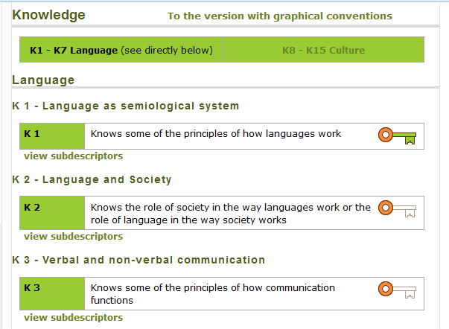
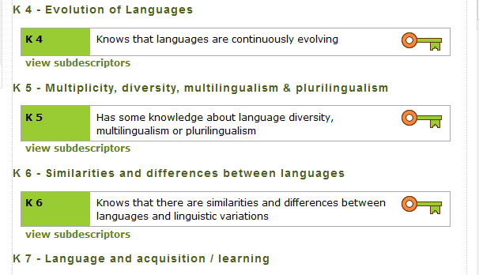
http://carap.ecml.at/
ディスクリプタは日本語を含む10言語以上で展開。
38
Notes:
I will give you some extracts from the descriptors, starting with the Knowledge list.
>> What you see now is the English version, as it can be found on the FREPA Website.
>> But the descriptors exist in more than ten languages, including Japanese.

Slide 39



http://carap.ecml.at/CARAPinEurope/tabid/3045/language/fr-FR/Default.aspx
Notes:
So that I will present them in the Japanese version. You can find it on the FREPA Website.

Slide 40
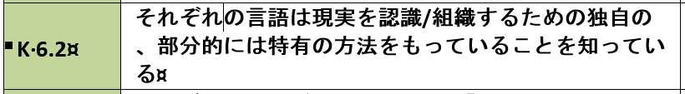
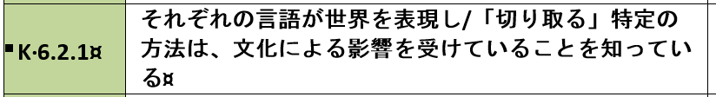
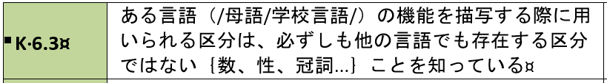
サブディスクリプタ
http://carap.ecml.at/CARAPinEurope/tabid/3045/language/fr-FR/Default.aspx
Notes:
≥ Each main descriptor is broken down into sub-descriptors.

Slide 41
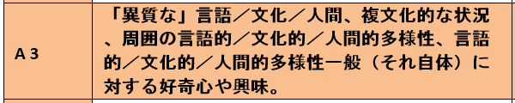



Slide 42
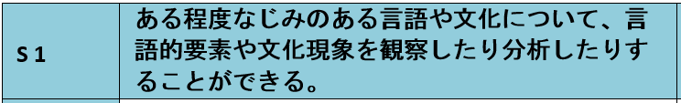
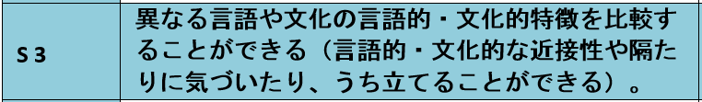
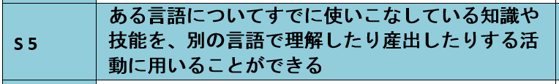
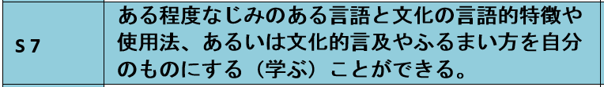

Slide 43
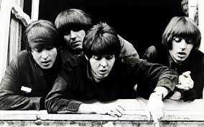

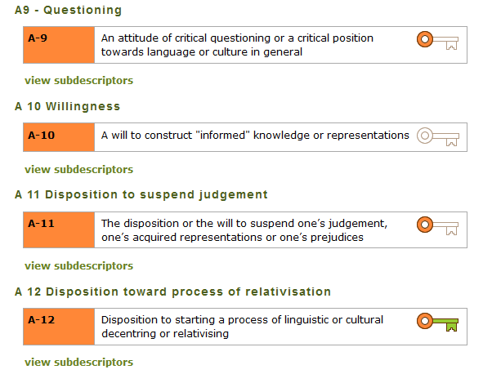
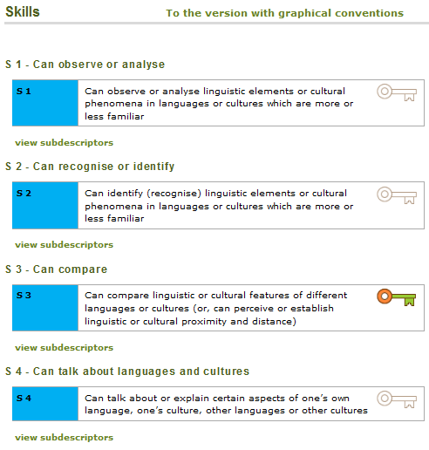
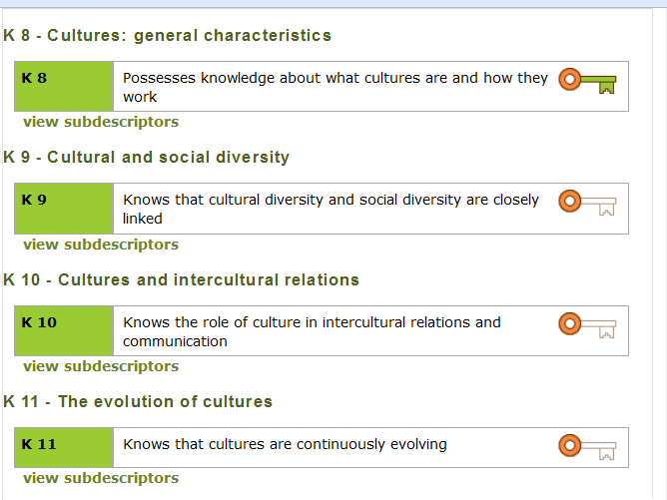
Where do they all come from?
これらは全部どこからやってきたのだろう？
Notes:
You may ask yourself, where all these descriptors come from.

Slide 44

4種類の複元的アプローチは40年の歳月をかけて形成された…
Integrated didactic approach
Awakening to languages
Intercultural approach(es)
Intercomprehension
この一覧を準備するために、FREPAの著者は、複元的アプローチについて書かれた約100種類の出版物から複言語及び相互文化能力に関する記述を抜粋し、統合した。
Notes:
The starting point for these lists was the pluralistic approaches themselves. Language teaching methodology has seen the emergence of four of them over the past 40 years : Awakening to languages, Integrated didactic approach, Intercultural approaches and Intercomprehension. You will learn more about these approaches right after.
>>In order to prepare the lists of descriptors, the authors of FREPA have collated extracts describing plurilingual and intercultural competences from around a hundred publications within the field of pluralistic approaches. These extracts have been synthesized and some additions have been made to fill in obvious gaps.

Slide 45
4種類の複元的アプローチ
相互文化的アプローチ
対象言語への統合型アプローチ
言語への目覚め活動
類縁言語間における相互理解
Notes:
Now a few words about each approach

Slide 46
4種類の複元的アプローチ
相互文化的アプローチ
よく知られているアプローチだが、未だに激しい論争の的になる。相互文化的アプローチの全てのバリエーションは、一つないし複数の文化的地域の現象を使用することが、一つ、あるいは多くの地域を理解する基盤になるという主張に依拠している。
Notes:
The intercultural approach is fairly well known, but it is still a matter of intensive debates, so that one should rather speak of "approaches" in the plural.
But all variants of intercultural approaches are based on principles advocating the use of phenomena from one or more cultural area(s) as a basis for understanding others from one or more other areas.

Slide 47
4種類の複元的アプローチ
対象言語への統合型アプローチ
数が限定された言語（カリキュラムのなかで教授されている言語）の間で学習者が関係性を確立するのを助ける。
＝ここで焦点があてられているアプローチ
Notes:
The integrated didactic approach to languages studied is directed towards helping learners to establish links between a limited number of languages - those which are taught within the school curriculum - not forgetting the major language of schooling.
According to what I knew of your needs, I have decided to focus on this approach.

Slide 48
4種類の複元的アプローチ
言語への目覚め活動
教育機関が教授対象に必ずしも定めていない言語に関連するアクティビティもある。
多くは年齢が小さい児童を対象としている。
また、年齢が大きい学生には、統合型アプローチと併せて行う。言語の多種多様性の利点を活かすため、あるいは学生が家庭で他の言語を話すときのため。
Notes:
Awakening to languages differs from the other pluralistic approaches insofar as some of the activities relate to languages which schools do not necessarily aim to teach. It is mainly designed for pupils from the very start of their schooling.
But it can also be used with older students, in conjunction with integrated didactics. Either when a greater diversity of languages helps to understand some grammatical features. Or when students speak other languages at home.

Slide 49
4種類の複元的アプローチ
類縁言語間における相互理解
同時に同族の言語（ロマンス諸語、ゲルマン諸語、スラブ諸語など）を2つあるいは3つ学んでいる学習者。
受容能力（の伸長）に体系的焦点がある。
日本の学生の場合：提示する言語の数を増やすために。たとえば、フランス語の後にポルトガル語。
Notes:
In the approach termed “intercomprehension between related languages” the learner works on two or more languages of the same linguistic family (Romance, Germanic, Slavic languages, etc.) in parallel – one of these languages being the learner’s mother tongue, the language of education, or another language learnt previously.
In this approach there is a systematic focus on receptive skills, as the development of comprehension is the most tangible way of using the knowledge and skills of a related language to learn a new one.
In the case of Japanese students, the Intercomprehension approach should be mainly considered as a way to still increase the number of languages offered. For instance Portuguese after French.

Slide 50
CARAP
FREPA
私たちのウェブサイトへようこそ！
Venez-voir sur notre site!!!
Les listes de savoirs, savoir-être et savoir-faire y sont …
Le CARAP, c’est nous !!!
50
Notes:
The FREPA website offers many other instuments.

Slide 51
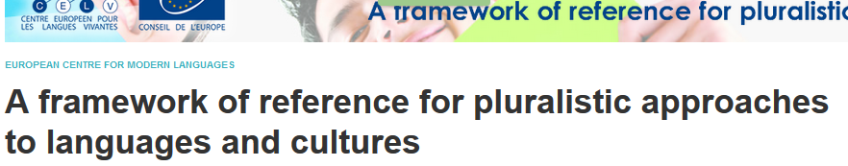
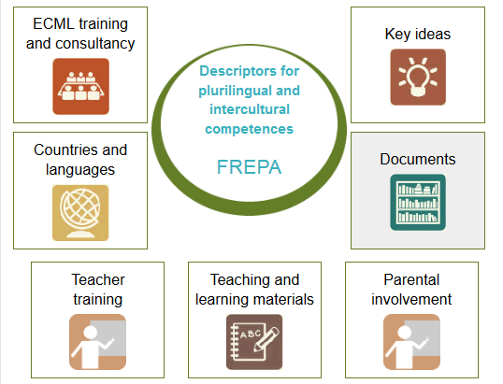
Notes:
The lists of descriptors are in the middle, as they are the core of FREPA.

Slide 52
さまざまな言語でのアクティビティ。全ての教材はディスクリプタに準拠しており、これらのディスクリプタに合わせて選ぶことができる。
Notes:
The online teaching materials database offers activities in different languages, for all pluralistic approaches. All the materials proposed refer explicitly to the descriptors and can be selected according to them.

Slide 53
教師と教師のトレーナーも利用可能（自己学習教材）。英語とフランス語で。
Notes:
The online self-learning kit is available for teachers and teacher trainers who wish to train in pluralistic approaches and in the use of FREPA materials.

Slide 54
評価に関する意見を二つ
New Council of Europe publication: North, Goodier & Piccardo (2017) CEFR Companion volume.
私の意見：ディスクリプタは複言語及び相互文化能力そのものの評価については考慮にいれていないー未だにコミュニケーション能力の評価でしかない (Candelier 2017, 73-76)
学習者の達成度の評価は必要であるが、結論には注意が必要。厳格な方式に則った累積評価あるいは検定的な評価は可能だが、多くの評価は育成的で、自己評価に重点を置くだろう。
Notes:
My final point will be on evaluation.
A provisional edition of a "companion volume" to the CEFR, proposing descriptors about plurilingual and intercultural education has been published by the Council of Europe last September.
This publication reflects the growing importance attached to these dimensions in European education systems. But, as I have tried to show in a recent article, these descriptors do not allow for the assessment of plurilingual and intercultural competences themselves. As in the rest of the CECR, it is still an assessment of communicative competence, this time in cases in which this competence makes use of plurilingual and intercultural competences (Candelier 2017, 73-76).
>> For this very complex issue of assessing plurilingual and intercultural competences, I would again advise you to read the Guide, which I agree with the statement you may read now.

Slide 55

tak
dank u wel
gmadlobth
obrigado
спасибо
tanemirt
Ευχαριστώ
enkosi
kiitos
misaotra
Notes:
55

