Slide 1
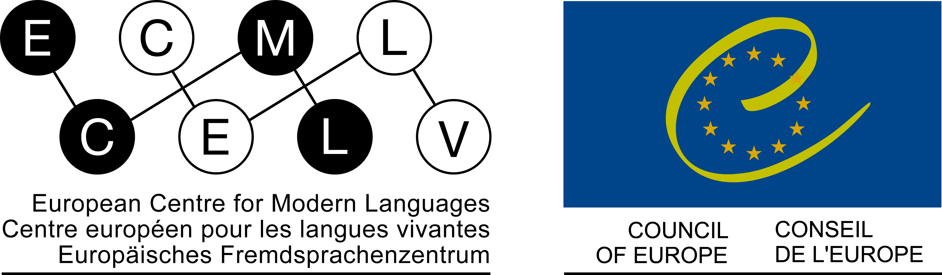


Michel Candelier
Linguistic competence and language education:
an integrative view and some instruments

Slide 2
What is Plurilingual education?
1- Plurilingualism /vs. / multilingualism
“plurilingualism is the ability to use more than one language” (Language is seen “from the standpoint of speakers and learners”)
“multilingualism […] refers to the presence of several languages in a given geographical area, regardless of those who speak them”.
(Guide for the development and implementation of curricula for plurilingual and intercultural education – Council of Europe, 2016, 20)
Notes:
In order to ensure that we understand each other correctly, first a question of terminology. What do I mean when I use the word « plurilingual » and its derivatives ?
According to the standard distinction made by the Council of Europe’s experts …
plurilingualism is the ability to use more than one language – this means: language is seen from the standpoint of speakers and learners
multilingualism […] refers to the presence of several languages in a given geographical area, regardless of those who speak them. It is more an external, sociological point of view.
As we know, there are many cases where two or more languages are present in an area, but only apart of the population can use more than one of them.
You can see the origin of this quotation. You will find the entire reference in the bibliography. I will use this Guide quite often and will just say « the Guide ».

Slide 3
What is Plurilingual education?
2- An additive /vs. / integrative procedure
Aiming at plurilingualism in and through education …
- not additive (quantitative): not simply increasing
the number of languages students have to learn
Integrative (qualitative): done through “the integration, convergence or cross-cutting organisation of all language teaching” (Guide, 16).
Notes:
Aiming at plurilingualism in and through education is not a matter of simply increasing the number of languages students have to learn. It is not an additive – a quantitative – matter.
It is a qualitative one, which requires the integration, convergence or cross-cutting organisation of all language teaching.
This is a crucial point – and maybe the most important one of what I would like to tell you. This assumes that you cannot reach your objectives for your students – such as developing interest for languages, improving language skills globally as well as the ability to learn languages – if you don’t take this integrative way.
My task is now to justify this assertion, but also to show what this means, including by concrete examples.

Slide 4
Why an integrative way ?
Plurilingual education has to take into account what the plurilingual competence of “speakers and learners” is (an obvious dimension of learner centered teaching).
A definition of plurilingual and pluricultural competence:
“a given individual does not have a collection of distinct and separate competences to communicate depending on the languages he/she knows, but rather a plurilingual and pluricultural competence encompassing the full range of the languages available to him/her”.
(Common European Framework of Reference for Languages, Council of Europe, 2000, 168).
Notes:
In order to be really « plurilingual », plurilingual education has to take into account what plurilingualism is. This means more precisely – because as we have just seen « plurilingualism » is something which has to do with le « standpoint of speakers and learners » - to take into account what plurilingual competence is. Which seems to be an obvious and essential dimension of learner centered teaching.
>> (>> = click) The definition promoted by the Council of Europe also includes cultural aspects, which are not the central topic of my conference today. But this definition does emphasise the aspects we need now to consider.
>> Please, read this definition:
“a given individual does not have a collection of distinct and separate competences to communicate depending on the languages he/she knows, but rather a plurilingual and pluricultural competence encompassing the full range of the languages available to him/her”
This range of languages an individual has a knowledge of – including those he or she partially knows – represents what is often called her or his repertoire.
What this definition states is that the plurilingual competence is not an addition of separate competences for each language the competence is made of. The competence has to be considered as a single one, covering all languages of the repertoire.

Slide 5
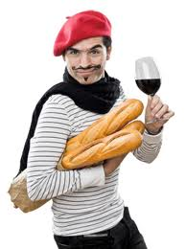
Here is a concrete example, in order to allow a better understanding of what this means:
…… it is about a speaker of French who knows German and tries to learn some Japanese.
Actually, it's about me when I stayed in Japan a few years ago!!! You will for sure recognize me!
For other people speaking French (and many other learners!) one of the difficulties in Japanese is to put the verb at the end of the sentence. I don't have this problem. Why?
Notes:
5
Our young friends would like to give you an example in order to allow a better understanding of what this means.
It is about a speaker of French who knows German and tries to learn some Japanese.
>> Actually, it's about me when I stayed in Japan a few years ago. You will for sure recognize me!
>>For other people speaking French (and many other learners!) one of the difficulties in Japanese is to put the verb at the end of the sentence. I don't have this problem. Why?

Slide 6
I have learnt German and have a good mastery of it.
わたし は
せんせい
です
Japanese
watashi wa
sensei
desu
I
teacher
am
V
(dass)
ich
Lehrer
bin
German
V
In German too, the verb is at the end, at least in dependant clauses!
Notes:
6
I have learnt German and have a good mastery of it.
….
>> And in German too, the verb is at the end, at least in dependant clauses!

Slide 7
While learning German, he has been introducing into his plurilingual competence the ability to build up sentences with the verb at the end.
Later on, this ability helped him constructing sentences in Japanese.
And it is at his disposal for other languages he would like to learn.…
Thus, his plurilingual competence is a global one: when trying to speak some Japanese, he uses an ability that is common to both Japanese and German!!
Notes:
7
While learning German, I have been introducing into my plurilingual competence the ability to build up sentences with the verb at the end.
>> Later on, this ability helped me constructing sentences in Japanese. And it is at my disposal for other languages I would like to learn.…
>> Thus, my plurilingual competence is a global one: when trying to speak some Japanese, I use an ability that is common to both Japanese and German!!

Slide 8
This conception of plurilingual competence relies on psycholinguistic research work carried out on language acquisition and use in the last decades.
For an overview of how this “holistic” (global) view has developed, see
Jessner (2008). Multicompetence approaches to language proficiency development in multilingual education.
A few essential elements…
"plurilingual" in our terminology
Notes:
This conception of plurilingual competence relies on psycholinguistic research work carried out on language acquisition and use in the last decades. You can find a very good overview of how this so called “holistic” – this means “global” - view of plurilingual competence has developed in a book by Herdina and Jessner.
I will now outline a few essential elements.
Note that most English-speaking authors still use “multilingual” here, instead of “plurilingual”.

Slide 9
Grosjean’s work (1985)
A holistic view of bilingualism
He strongly influenced both…
… Cook’s concept of
multicompetence
(1991)…
…and Herdina and Jessner’s (2002) dynamic view of multilingual development and multilingual proficiency
Notes:
Everything has started with Grosjean, who was the first linguist to introduce a holistic view of bilingualism.
He strongly influenced both Cook’s concept of “multicompetence” and Herdina’s and Jessner’s dynamic view of plurilingualism.

Slide 10
Grosjean’s plurilingual view of bilingualism:
Bilinguals are NOT the sum of two monolinguals. They have a specific linguistic configuration that is resulting from the coexistence and constant interaction of the two languages they have a command of.
Cook’s concept of
multicompetence
(e.g. 1991)…
…Herdina and Jessner’s (2002) dynamic view of multilingual development and multilingual proficiency
Notes:
According to Grosjean, bilinguals are NOT the sum of two monolinguals. They have a specific linguistic configuration that is resulting from the coexistence and constant interaction of the two languages they have a command of.

Slide 11
Bilingual View of Bilingualism:
Grosjean (1982, 1985) …
Cook’s concept of multicom-petence (1991):
Herdina and Jessner’s Dynamic model of Multilingualism (DMM) (2002) :
“[…] we assume that the phenomenon of bilingualism […] is essentially a variant of multilingualism […] and that many of the findings […] can therefore be generalised to cover all variants of multilingualism.
DMM views a multilingual speaker as a complex psycholinguistic system comprising individual language systems […]”.
As a consequence…
The construction of any further individual language system must be carried out in conjunction with existing individual language systems. This is exactly what we called “the integrative way”
Notes:
For reasons of time, I'm going to leave aside Cook’s concept and I’m focusing on Herdina’s and Jessner’s Dynamic model of Multilingualism (DMM).
The first assertion is that bilingualism is a particular case of plurilingualism – in their words multilingualism. And that what is said by Grosjean for bilingualism is also true for plurilingualism.
The second one is exactly what has been said above concerning plurilingual competence: the plurilingual speaker “is a complex psycholinguistic system comprising individual language systems”.
As a consequence :
>> The construction of any further individual language system must be carried out in conjunction with existing individual language systems. This is exactly what we called “the integrative way”.

Slide 12
First concrete examples
A specific difficulty in French: the two meanings of « un »:
J’ai acheté un livre
我买了书。
我买了一本书。
I have bought a book
I have bought one book
Taken from Cuet C., Li Z., Marguerie A., 2008. Français, communication et pratique. (French for Chinese students)
Notes:
I have also promised some concrete examples. Just to show that these principles lead to very concrete and often simple measures.
The first one will be taken from a textbook of French for Chinese students. But it deals with a problem Japanese students also have to face.
>> In French, « un » stands either for the indefinite article or for the numeral « one ». « J’ai acheté un livre » can mean « a book » or « one book ».
The challenge is made all the more difficult by the fact that Chinese has no article.
>> For students having already learnt English, English is the language in which they have developed the notion of article, and it does have two forms, one for the numeral, and one for the article. So that the way through English should help them.
This “way trough English” is not an additional means to be used as a simple remark.
In consideration of the existing plurilingual competence of the students, it is the only proper strategy to be adopted.
This is just one case among many. So that helping students to develop competences in any further language needs to be seen as a common task to be reflected upon by all those who are in charge of the languages of the curriculum.

Slide 13
2d example: Activity for students at university level. Course in plurilingual education by Mayo Oyama (Kyoto)
ETAT-NATION : DEFINITION DE L’UNESCO
"L'Etat-nation est un domaine dans lequel les frontières culturelles se confondent aux frontières politiques. L'idéal de l'Etat-nation est que l'Etat incorpore les personnes d'un même socle ethnique et culturel. Cependant, la plupart des Etats sont polyethniques. Ainsi, l'Etat-nation "existerait si presque tous les membres d'une seule nation étaient organisés en un seul Etat, sans autres communautés nationales présentes. Bien que le terme soit souvent usité, de telles entités n'existent pas". Try to understand it !
Notes:
For a second example, I have chosen an activity designed by Mayo Oyama, our colleague from Kyoto, who teaches an intermediate French class employing plurilingual teaching materials. She is taking part in our symposium and you can ask her later on for more details.
This seems to be a quite difficult text in French. Maybe, you start reading the beginning …
…
I think you were able to get the meaning quite properly. If you have thought of “confusion” for “confondre”, you were likely to get a thorough comprehension of the first sentence.

Slide 14
"L'Etat-nation est un domaine dans lequel les frontières culturelles se confondent aux frontières politiques.
L'idéal de l'Etat-nation est que l'Etat incorpore les personnes d'un même socle ethnique et culturel.
Cependant, la plupart des Etats sont polyethniques.
Ainsi, l'Etat-nation existerait si presque tous les membres d'une seule nation étaient organisés en un seul Etat, sans autres communautés nationales présentes.
Bien que le terme soit souvent usité, de telles entités n'existent pas"
Notes:
Indeed, this is true of the whole text. Of course, this text belongs to a domain – that of politics – where languages like Greek and Latin have had an important influence on different European languages.

Slide 15
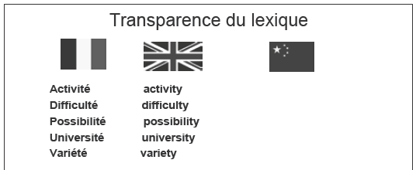
Taken from Cuet C., Li Z., Marguerie A., 2008.
sincérité
curiosité
égalité
réalité
amabilité
sincerity
curiosity
egality
reality
amability
Also in general areas of vocabulary !
Notes:
But lexical similarity occurs quite often between French and English, also in non specialised areas of vocabulary.
>> As you see, correspondences can be established between morphological elements.

Slide 16
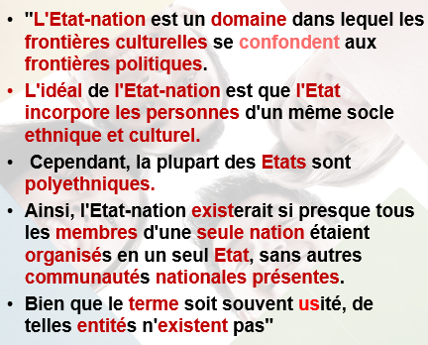
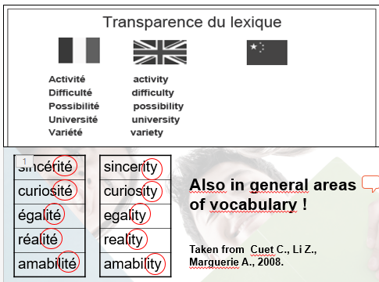
Motivation for learning languages and more languages!
Encourages students to look for help when learning a
language in other languages they know.
Students develop useful plurilingual strategies.
By no means a waste of time for learning French.
Reinforces competences in English.
Why not during common lessons English + French ?
Notes:
Such activities are important for motivation – motivation for learning languages and more languages.
They encourage the students learning a language to look for help in other languages they know.
And this includes Japanese - think about the many borrowings in Japanese.
In this way, students develop useful strategies, plurilingual strategies.
This is by no means a waste of time for learning French. And this reinforce competences of English, so that one could think of doing this work during teaching hours that would be common to both languages.

Slide 17
What I have told you so far is the essential part of what I can tell you, given what I think I know about the questions you are asking yourself.
In the following:
Other principles concerning plurilingual education
Other examples (beyond lexical aspects)
A framework of reference (knowledge, attitudes and skills to develop through plurilingual and intercultural education)
Notes:
What I have told you so far is the essential part of what I can tell you, given what I think I know about the questions you are asking yourself.
>> In the following,
I will first complement the principles already stated concerning plurilingual education.
I will then present other examples which will go beyond the lexical aspects.
And I will present a framework of reference with lists of knowledge, attitudes and skills to develop through plurilingual and intercultural education that can be useful to you in the future.

Slide 18
Other principles concerning plurilingual education
Similarities … and dissimilarities :
“The development of cross-linkages calls for utilisation of the similarity and dissimilarity between languages in the curriculum […] contrastive methodology will also bring out the distinctive features and the diﬀerences” (Guide, 11, also 2.6)
In order to “find their way” through languages, students need to have also a clear view of what is different.
Notes:
As we are limited in time, I will state these principles quickly, with few comments. They are taken from the guide we started with. I invite you to continue your reflection at a later stage on the basis of the developments that the guide provides on these themes.
>> The first principle claims that it is not enough to make similarities manifest. The differences are also important :
“The development of cross-linkages calls for utilisation of the similarity and dissimilarity between languages in the curriculum
[…] contrastive methodology will also bring out the distinctive features and the diﬀerences.” (more in 2.6)
Of course, similarities are the most striking argument in favor of plurilingual approaches – the most visible one. But students need to “find their way” through languages. In order to do this, they also need to have a clear view of what is different.

Slide 19
Other principles concerning plurilingual education
Reflexivity, learning to learn, autonomy:
“[In the Guide] particular attention is paid to approaches encouraging reﬂexivity in grammar teaching. […] such activities would benefit from a more cross-cutting perspective, since there is nothing to prevent one language from being analysed on the basis of data stemming from others. […]. This recourse to other languages is always revealing, since the change of focus highlights how languages function by pinpointing contrasts.”
« grammar » includes other types of regularities
« reflexivity in grammar teaching » = explicit grammar + inductive methodology
Notes:
I've put together the principles that relate to reflexivity, the competence to learn and learner autonomy.
>> Please, read the quotations :
“[In the Guide] particular attention is paid to approaches encouraging reﬂexivity in grammar teaching. […] such activities would benefit from a more cross-cutting perspective, since there is nothing to prevent one language from being analysed on the basis of data stemming from others. […]. This recourse to other languages is always revealing, since the change of focus highlights how languages function by pinpointing contrasts.” (Guide, 11, 42 – see 2.4)
>> Some remarks are needed:
In “grammar teaching”, grammar has to be understood very broadly: it includes other types of regularities in the linguistic system and even such concerning the use of language.
What is meant here is often dealt with in terms of explicit grammar. But the choice of “reflexivity” instead of “explicit” is important. This is why the guide devotes a great deal of attention to the question of modalities of grammatical reflection, putting inductive methodology in the centre of its recommendations and recognizing that it is still very remote from the professional culture of most language teachers and learners.

Slide 20
Other principles concerning plurilingual education
Reflexivity, learning to learn, autonomy:
“[…] reﬂexivity serves to establish an element of distance from [cognitive activities] in the form of a certain awareness of the processes used in learning. […] It is generally agreed that this distancing process improves their capacity for acquiring and transferring knowledge […]
[The aim being] the development of learner autonomy, the ability of learners to think about the aims pursued and their linguistic and (inter)cultural experiences, the progress they are making and any critical observations they may have.” (Guide, 38, 28)
Notes:
Again, read the quotations. It is now about reflexivity in a broader sense, not limited to regularities in languages, but applying also to cognitive activity by learning, thus promoting the development of the competence to learn and more generally learner autonomy :
“[…] reﬂexivity serves to establish an element of distance from [cognitive activities] in the form of a certain awareness of the processes used in learning. […] It is generally agreed that this distancing process improves their capacity for acquiring and transferring knowledge […] (Guide, 38)
[The aim being] the development of learner autonomy, the ability of learners to think about the aims pursued and their linguistic and (inter)cultural experiences, the progress they are making and any critical observations they may have.”

Slide 21
Other principles concerning plurilingual education
Reflexivity, learning to learn, autonomy:
Addition to what has been said about grammatical reflectivity:
“[…] more should be done to relate the main language of schooling to the foreign languages taught, not only when the latter are being taught but also in the language of schooling as a subject.” (Guide, 41)
Focusing on the learner foreign languages teachers must take into account the language of schooling as an essential element of his/her repertoire.
Notes:
In addition to what has been said about grammatical reflectivity, some words about the main language of schooling – in your case, Japanese:
Plaese, read this short quotation :
“more should be done to relate the main language of schooling to the foreign languages taught, not only when the latter are being taught but also in the language of schooling as a subject”.
>> It is only understandable that teachers of foreign languages think first of all about teaching these languages, but if they really want to focus on the learner, they must take into account the language of schooling as it is an essential element of their repertoire.

Slide 22
Other principles concerning plurilingual education
Plurilingual … and intercultural education:
“Plurilingual and intercultural education has two aims. First, it facilitates the acquisition of linguistic and intercultural abilities […] Secondly, it promotes personal development […]: this involves encouraging [individuals] to respect and accept diversity of languages and cultures in a multilingual and multicultural society […].” (Guide, 15)
The Guide uses two terms:
“Pluriculturality denotes the ability to participate in diﬀerent cultures. Intercultural competence, for its part, is the ability to experience otherness and cultural diversity […].” (Guide, 10)
Notes:
As already suggested, plurilingual education goes hand in hand with plurilingual / intercultural education, which is not the aspect I am supposed to develop here.
Two quotations on this point:
>> “Plurilingual and intercultural education has two aims. First, it facilitates the acquisition of linguistic and intercultural abilities […] Secondly, it promotes personal development […]: this involves encouraging [individuals] to respect and accept diversity of languages and cultures in a multilingual and multicultural society […].”
More and more terms are used in the complex domain of education to cultural diversity.
>> The Guide tries to cover it with two of them : Pluriculturality, which has more to do with the cultural repertoire of the invidual, and interculturality, which focuses on the relationship to others.
“Pluriculturality denotes the ability to participate in diﬀerent cultures.
Intercultural competence, for its part, is the ability to experience otherness and cultural diversity […].” (Guide, 10)

Slide 23
Other principles concerning plurilingual education
Plurilingual and intercultural education and society:
“These diﬀerent components of plurilingual and intercultural education tend to foster inclusion and social cohesion; they are a preparation for democratic citizenship and contribute to the establishment of a knowledge society.” (Guide, 16)
Notes:
And the Guide shows how plurilingual and intercultural education is connected with global aims concerning society: inclusion, social cohesion, democratic citizenship and a knowledge society.
.

Slide 24
Further examples – beyond lexical aspects
Example for German after English, taken from Kursiša, A. & Neuner, G. (2006)
It is about modal verbs in both languages
I really must go now
Ich muss jetzt aber wirklich gehen
Notes:
Now a second series of examples that will be a little more complex than the first one.
We start with students learning German after English. It is about modal verbs in both languages.
>> It should be obvious that somebody having already learnt I really must go now will try – consciously or not – to establish links with English when learning Ich muss jetzt aber wirklich gehen.

Slide 25
Also differences! (in the grammatical domain of word order)
Compare with their own language: no modal verb in Japanese!
Notes:
This material helps students to discover not only lexical similarities, but also differences that exist in the grammatical domain of word order.
>>They also compare with their own mother tongue (and / or language of education), which would be all the more interesting for your students as these forms do not exist in Japanese.

Slide 26
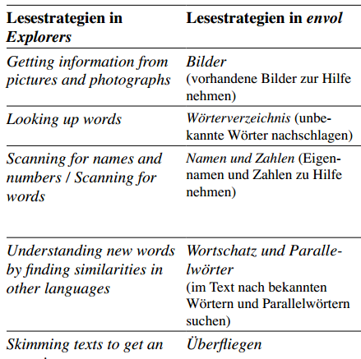
Further examples – beyond lexical aspects
Reflexivity on own reading strategies
The students (at secondary level) learn French (course book: Envol) after English (course book: Explorers).
(Taken from Achermann, B. 2009)
Reading strategies in Explorers
Reading strategies in Envol
You have already reflected on reading strategies in each textbook.
Compare the formulations in each textbook and indicate your preferred strategies.
Plurilingual strategy!
Notes:
The next example is no longer about reflexivity on how languages work, but on own strategies.
>> The students - at secondary level - learn French (with the course book: Envol) after English (course book: Explorers).
>> They are reminded that they have already reflected on reading strategies in each textbook, and they are asked to compare the formulations in each textbook and to indicate their preferred strategies.
One of these strategies is looking for similarities with languages they already know. It is a plurilingual strategy.

Slide 27
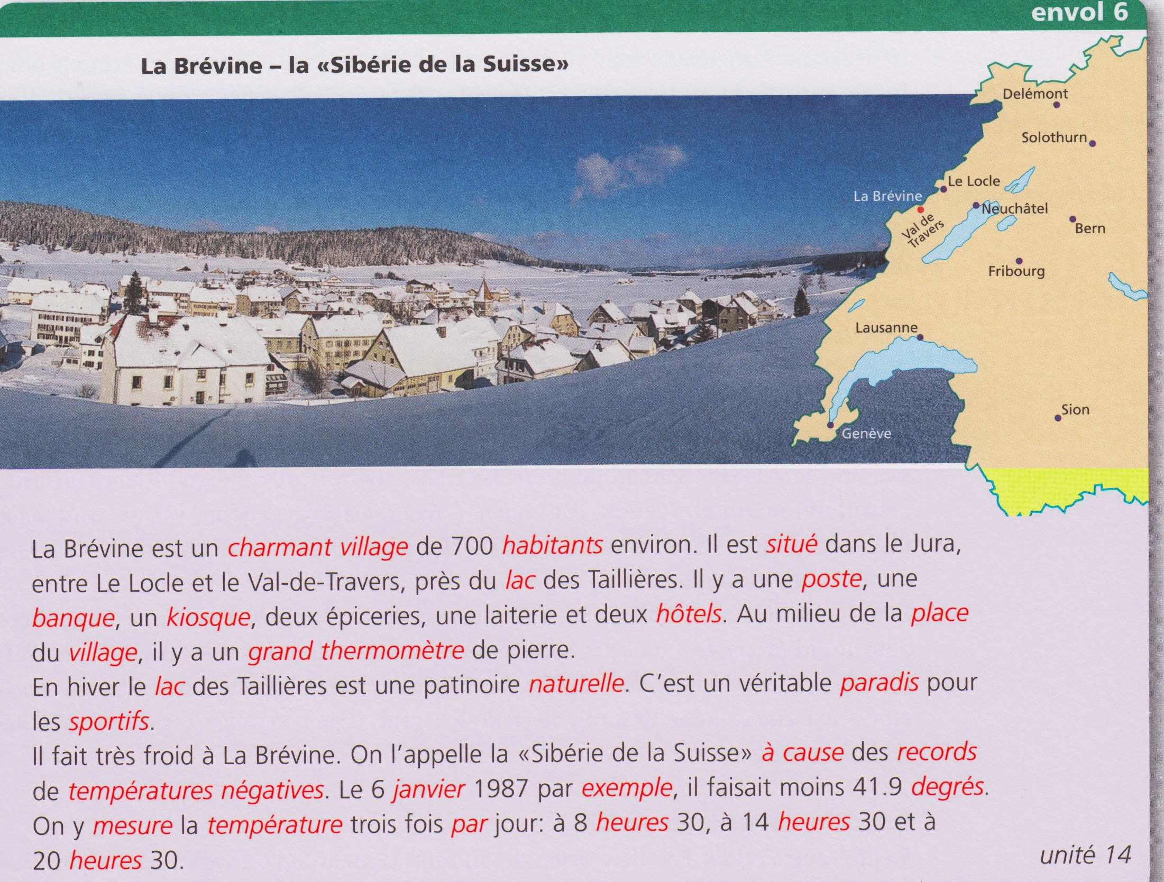
(Lexical) similarities = the underpinning for a plurilingual reading strategy to be used along with other strategies.
Egli Cuenat M. et al., 2018
Notes:
… (le temps de regarder)
>> Similarities - particularly lexical ones - between languages are therefore the underpinning for a plurilingual reading strategy, which students are encouraged to use along with other strategies.

Slide 28
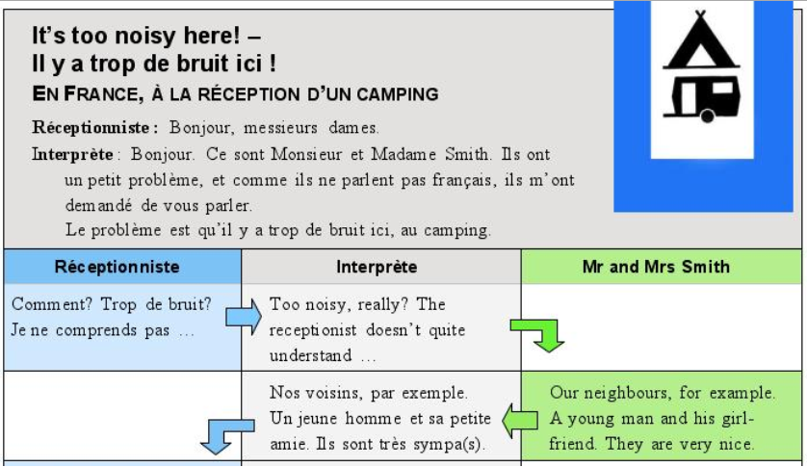
Further examples – beyond lexical aspects
Mediation activity for German secondary school students.
Three-person constellation in which a learner takes on the role of a language mediator – an “interpreter” - between English and French-speaking persons, since they do not speak the other language. This takes place on a camping site in France.
Mediation activity
Notes:
…
This so-called „mediation“ activity is also for German secondary school students, but the situation is equally suitable for university students.
This is a three-person constellation in which a learner takes on the role of a language mediator – an “interpreter” - between English and French-speaking persons, since this persons do not speak the other language. This is supposed to take place on a camping site in France.
.

Slide 29
Further examples – beyond lexical aspects
Receptionist (in French) : "Hello" …
Mediator (in French) : "Mr and Mrs Smith asked me to talk to you … It is too noisy here! "
Mediation activity
Receptionist (in French) : « How, too much noise? I don't see what they mean."
Mediator (in English) : "Too noisy, really? The receptionist doesn’t quite understand."
Mrs Smith (in English) : "Our neighbours, for example. A young man and his girl-friend. They are very nice…"
Mediator (in French) : Our neighbours, for example. A young man and his girl-friend. They are very nice…"
Mediation = translation, interpretation, summary or report
Notes:
…
…
>> As you can already see, mediation is not about giving an accurate translation of what has been said. Other forms of mediation are interpretation, summary or report.
.

Slide 30
Further examples – beyond lexical aspects
Mediation activity
This very simple example of mediation gives you a limited view as to the potential of this type of teaching and learning activity.
Notes:
This is a very simple example of mediation, which gives you only a limited view as to the potential of this type of teaching and learning activity.
.

Slide 31
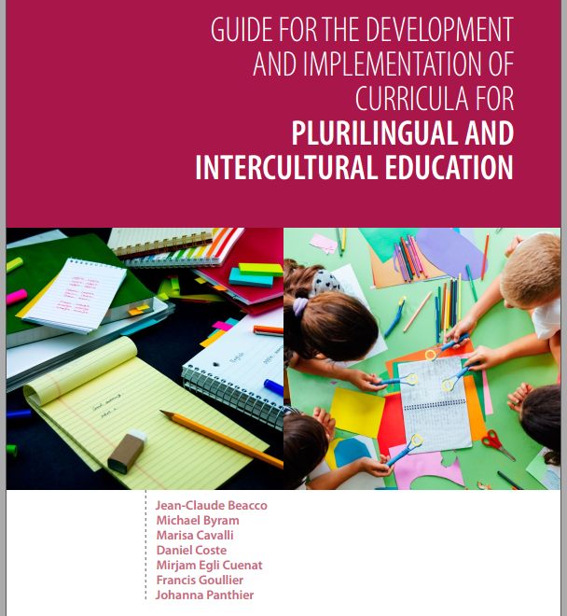
To know more, see the Guide (53-59)
Linguistic mediation = a special case of mediation conceived as a general phenomenon omnipresent in all teaching and learning processes
The cultural dimension of mediation activities
The central role of mediation in plurilingual and intercultural education
(with a strong reference to FREPA)
Notes:
I would strongly advise you to have a look at what the Guide says about this. You will learn more about:
>> Linguistic mediation (what we have just seen) as a special case of mediation conceived as a general phenomenon that is omnipresent in all teaching and learning processes.
>>The importance of the cultural dimension of mediation activities.
>> The central role of mediation in plurilingual and intercultural education.
Here, you will find a strong reference to FEPA, the framework I would like to present now.

Slide 32
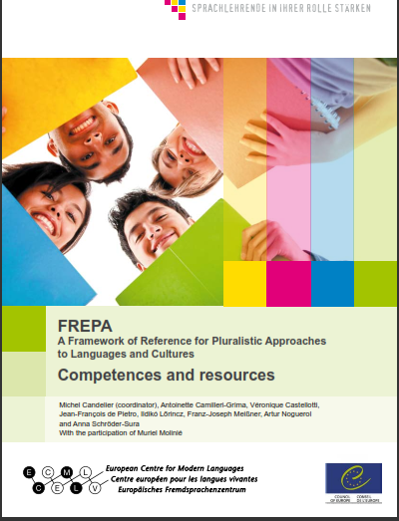
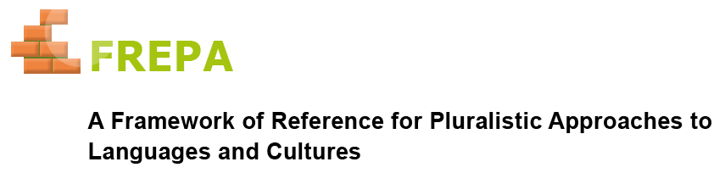
FREPA – An instrument for plurilingual and intercultural education
An instrument that can help you to think in concrete terms about the teaching and learning objectives of plurilingual education (see Guide, 69).
Notes:
This instrument is not made just for Mediation, but for all aspects of plurilingual and intercultural education. It can help you to think in concrete terms about the teaching and learning objectives of plurilingual education, and thus to organise collectively an education that puts languages in relation to each other.
>>
>> I coordinated the development of this instrument at the European Center for Modern Languages in Graz, which is also an institution of the Council of Europe.

Slide 33
What are Pluralistic Approaches?
One can distinguish two kinds of teaching approaches :
Pluralistic approaches to languages and cultures, referring to didactic approaches which use teaching / learning activities involving several (i.e. more than one) varieties of languages or cultures;
Approaches called “singular approaches” in which the didactic approach takes account of only one language or a particular culture, and deals with it in isolation.
Integrating all language teaching (Plurilingual education)
Notes:
But I presume you'd like to know first of all what pluralistic approaches are.
Please, read the definitions carefully.
(ne pas lire)
>> If you are supposed to integrate all language teaching, as we said above, you must plan some activities involving several languages. You can’t do it by dealing with languages in isolation.

Slide 34
What are Pluralistic Approaches?
One can distinguish two kinds of teaching approaches :
Pluralistic approaches to languages and cultures, referring to didactic approaches which use teaching / learning activities involving several (i.e. more than one) varieties of languages or cultures;
Approaches called “singular approaches” in which the didactic approach takes account of only one language or a particular culture, and deals with it in isolation.
Singular approaches are not replaced by pluralistic approaches. Singular approaches are enriched by pluralistic approaches.
This also applies to the cultural dimensions of plurilingual and intercultural education
Integrating all language teaching (Plurilingual. education)
Notes:
This does not mean that you do not keep concentrating learners' efforts on a particular language at certain points in the learning process. But it is essential to provide for other phases where you have the languages linked to each other. This means phases of pluralistic approaches.
In other words: singular approaches are not replaced by pluralistic approaches. Singular approaches are enriched by pluralistic approaches.
>>This also applies to the cultural dimensions of plurilingual and intercultural education.

Slide 35
Plurilingual and intercultural education requires pluralistic approaches.
What are Pluralistic Approaches?
One can distinguish two kinds of teaching approaches :
Pluralistic approaches to languages and cultures, referring to didactic approaches which use teaching / learning activities involving several (i.e. more than one) varieties of languages or cultures;
Approaches called “singular approaches” in which the didactic approach takes account of only one language or a particular culture, and deals with it in isolation.
Singular approaches are not replaced by pluralistic approaches. Singular approaches are enriched by pluralistic approaches
This also applies to the cultural dimensions of plurilingual and intercultural education
Integrating all language teaching (Plurilingual. education)
Notes:
Thus, plurilingual and intercultural education requires pluralistic approaches.

Slide 36
Plurilingual and intercultural education requires pluralistic approaches.
[…] approaches that are designated as plural […] deserve to be studied and applied by language teachers. (Guide, 51).
Notes:
This is why they are explicitly mentioned and recommended in the Guide, even if it calls them “plural” approaches.

Slide 37
FREPA descriptors
The descriptors indicate the teaching / learning objectives you can reach by using pluralistic approaches and give plurilingual education a concrete content!
All levels of instruction! Choice to be made by teachers / teacher team. Choice can be guided by a Tables of descriptors across the curriculum (available on the FREPA Website).
Notes:
Let’s come back now to the Framework of reference for pluralistic approaches and to its core, the list of descriptors that indicates the teaching and learning objectives you can reach by using pluralistic approaches – and thus giving plurilingual education a concrete content.
>> The descriptors cover all levels of instruction. Users have to make their own choice in reference to their learners. Some advice for this is given by a Tables of descriptors across the curriculum, which you can also find on the FREPA website.

Slide 38
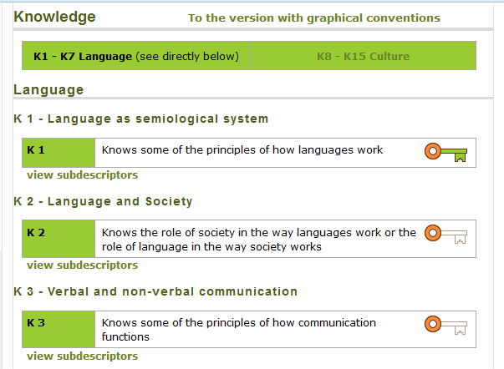
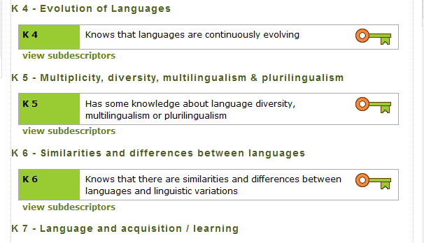
http://carap.ecml.at/
Descriptors in more than ten languages, including Japanese.
38
Notes:
I will give you some extracts from the descriptors, starting with the Knowledge list.
>> What you see now is the English version, as it can be found on the FREPA Website.
>> But the descriptors exist in more than ten languages, including Japanese.

Slide 39



http://carap.ecml.at/CARAPinEurope/tabid/3045/language/fr-FR/Default.aspx
Notes:
So that I will present them in the Japanese version. You can find it on the FREPA Website.

Slide 40
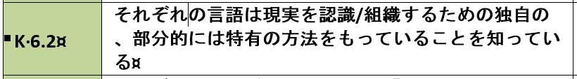
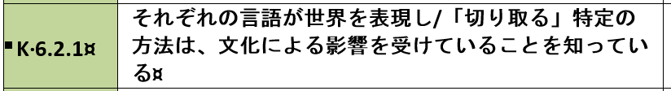
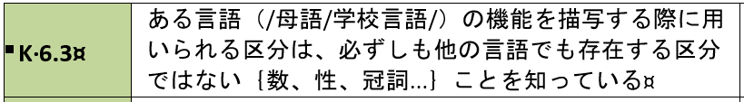
Sub-descriptors
http://carap.ecml.at/CARAPinEurope/tabid/3045/language/fr-FR/Default.aspx
Notes:
Each main descriptor is broken down into sub-descriptors.

Slide 41
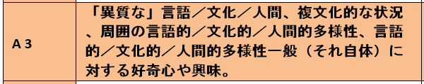



Slide 42
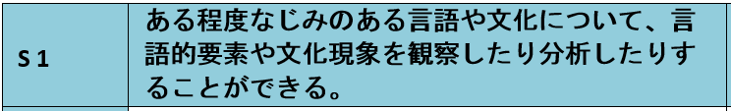
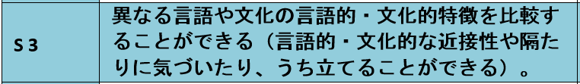
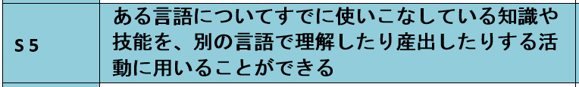
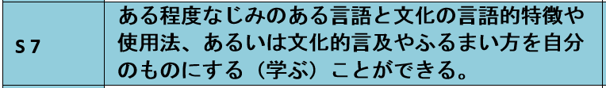

Slide 43
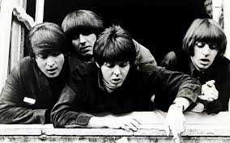

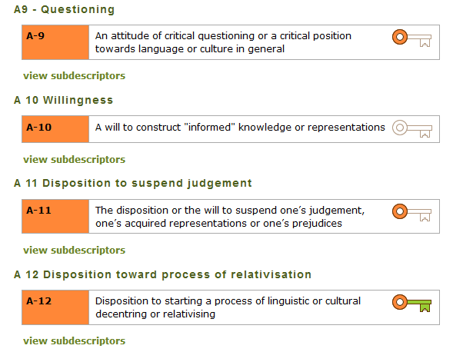
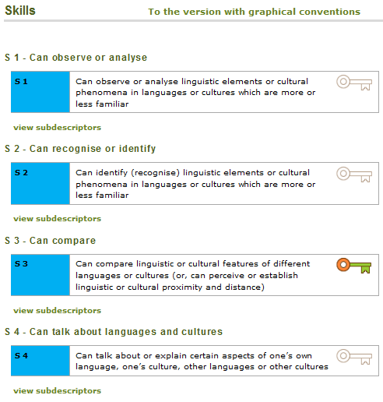
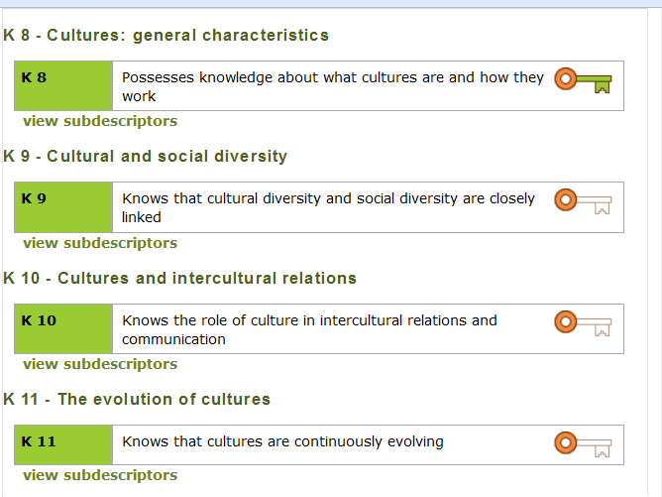
Where do they all come from?
Notes:
You may ask yourself, where all these descriptors come from.

Slide 44

Four pluralistic approaches have emerged over the past 40 years…
Integrated didactic approach
Awakening to languages
Intercultural approach(es)
Intercomprehension
In order to prepare the lists the authors of FREPA have synthesized extracts describing plurilingual and intercultural competences from around a hundred publications within the field of pluralistic approaches.
Notes:
The starting point for these lists were the pluralistic approaches themselves. Language teaching methodology has seen the emergence of four of them over the past 40 years : Awakening to languages, Integrated didactic approach, Intercultural approaches and Intercomprehension. You will learn more about these approaches right after.
>>In order to prepare the lists of descriptors, the authors of FREPA have collated extracts describing plurilingual and intercultural competences from around a hundred publications within the field of pluralistic approaches. These extracts have been synthesized and some additions have been made to fill in obvious gaps.

Slide 45
Four pluralistic approaches
Intercultural approach(es)
Integrated didactic approach to languages studied
Awakening to languages
Intercomprehension between related languages
Notes:
Now a few words about each approach

Slide 46
Four pluralistic approaches
Intercultural approach(es)
It is fairly well known, but it is still a matter of intensive debates.
All variants of intercultural approaches are based on principles advocating the use of phenomena from one or more cultural area(s) as a basis for understanding others from one or more other areas
Notes:
The intercultural approach is fairly well known, but it is still a matter of intensive debates, so that one should rather speak of "approaches" in the plural.
But all variants of intercultural approaches are based on principles advocating the use of phenomena from one or more cultural area(s) as a basis for understanding others from one or more other areas.

Slide 47
Four pluralistic approaches
Integrated didactic approach to languages studied
It is directed towards helping learners to establish links between a limited number of languages - those which are taught within their curriculum.
= the approach that has been focused on here.
Notes:
The integrated didactic approach to languages studied is directed towards helping learners to establish links between a limited number of languages - those which are taught within the school curriculum - not forgetting the major language of schooling.
According to what I knew of your needs, I have decided to focus on this approach.

Slide 48
Four pluralistic approaches
Awakening to languages /
“Language awareness”
Some of the activities relate to languages which schools do not necessarily aim to teach.
Mostly for younger students.
Also with older students, in conjunction with integrated didactics. To take advantage of a greater diversity of languages or when students speak other languages at home.
Notes:
Awakening to languages differs from the other pluralistic approaches insofar as some of the activities relate to languages which schools do not necessarily aim to teach. It is mainly designed for pupils from the very start of their schooling.
But it can also be used with older students, in conjunction with integrated didactics. Either when a greater diversity of languages helps to understand some grammatical features. Or when students speak other languages at home.

Slide 49
Four pluralistic approaches
Intercomprehension between related languages
The learner works on two or more languages of the same linguistic family (Romance, Germanic, Slavic languages, etc.) in parallel.
Systematic focus on receptive skills.
For Japanese students: to increase the number of languages offered. For instance Portuguese after French.
Notes:
In the approach termed “intercomprehension between related languages” the learner works on two or more languages of the same linguistic family (Romance, Germanic, Slavic languages, etc.) in parallel – one of these languages being the learner’s mother tongue, the language of education, or another language learnt previously.
In this approach there is a systematic focus on receptive skills, as the development of comprehension is the most tangible way of using the knowledge and skills of a related language to learn a new one.
In the case of Japanese students, the Intercomprehension approach should be mainly considered as a way to still increase the number of languages offered. For instance Portuguese after French.

Slide 50
CARAP
FREPA
Welcome to OUR website!
Venez-voir sur notre site!!!
Les listes de savoirs, savoir-être et savoir-faire y sont …
Le CARAP, c’est nous !!!
50
Notes:
The FREPA website offers many other instuments.

Slide 51
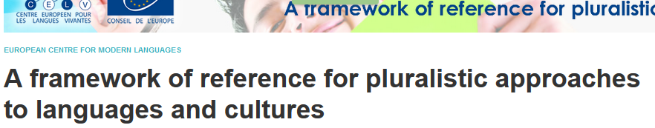
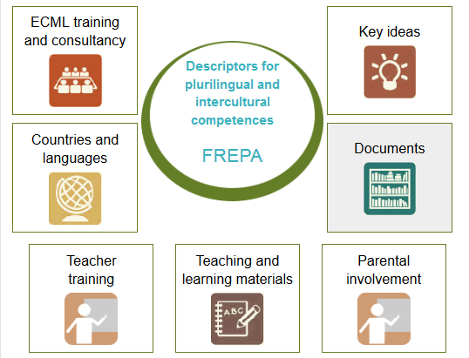
Notes:
The lists of descriptors are in the middle, as they are the core of FREPA.

Slide 52
Activities in different languages. All the materials proposed refer explicitly to the resource descriptors and can be selected according to these descriptors.
Notes:
The online teaching materials database offers activities in different languages, for all pluralistic approaches. All the materials proposed refer explicitly to the descriptors and can be selected according to them.

Slide 53
Available for teachers (self-learning material) and teacher trainers. In English and French.
Notes:
The online self-learning kit is available for teachers and teacher trainers who wish to train in pluralistic approaches and in the use of FREPA materials.

Slide 54
Two words about assessment
New Council of Europe publication: North, Goodier & Piccardo (2017) CEFR Companion volume.
In my opinion: do not allow for the assessment of plurilingual and intercultural competences themselves – it is still an assessment of communicative competence (Candelier 2017, 73-76)
Assessment of learners’ achievements is necessary, but caution is needed in reaching conclusions. Summative or certification assessment is possible, using stringent methods, but most assessment will be formative, and emphasise self-assessment.
Notes:
My final point will be on evaluation.
A provisional edition of a "companion volume" to the CEFR, proposing descriptors about plurilingual and intercultural education has been published by the Council of Europe last September.
This publication reflects the growing importance attached to these dimensions in European education systems. But, as I have tried to show in a recent article, these descriptors do not allow for the assessment of plurilingual and intercultural competences themselves. As in the rest of the CECR, it is still an assessment of communicative competence, this time in cases in which this competence makes use of plurilingual and intercultural competences (Candelier 2017, 73-76).
>> For this very complex issue of assessing plurilingual and intercultural competences, I would again advise you to read the Guide, which I agree with the statement you can read now.

Slide 55

tak
dank u wel
gmadlobth
obrigado
спасибо
tanemirt
Ευχαριστώ
enkosi
kiitos
misaotra
Notes:
55

